Slide 1



PARENTAL CULTURAL SOCIALIZATION ON MEXICAN-AMERICAN YOUNG ADULTS' ETHNIC IDENTITIES
WORKFLOW & CRITIQUE
CINTHYA NAVARRO-GARCIA

Slide 2



Workflow
  Raw Data
    Self-report survey administered via Qualtrics
    Exported as a CSV file
  Data processing:
    Importing CSV file
    Data cleaning
      Renaming variables
      Filter incomplete responses
    Variable transformation
      Likert scales
        Recode to factors
        Compute scale reliabilities
        Creating composite scores

Slide 3


Critique: Sharing & Reproducibility
  File paths
    data<-read.csv("C:/Users/Cassandra Garcia/Downloads/CJG_McNair Study 2 - Quant 1(in).csv")
      Absolute file paths
        Starts from the root of the drive
          Start with an RStudio Project and use here()
          Use relative file paths
  Naming
    File names:
      McNair Study 2 R code. R
      CJG_McNair Study 2 - Quant 1(in).csv
        Inconsistent and has unnecessary information
          Create detailed but concise names
    Variable names:
      e.g., etso-mex_3
        Mix of snake_case, CamelCase, kebab-case, and spaces
          Use snake_case for all files in a project
  Documentation
    Add a README file
Notes:
relative path: starts from the working directory
here() finds the project root from the .Rproj file and builds paths from it
read_csv is tidyverse (readr package) read_csv is faster. makes fewer assumptions about your data, can combine multiple data files into one

Slide 4
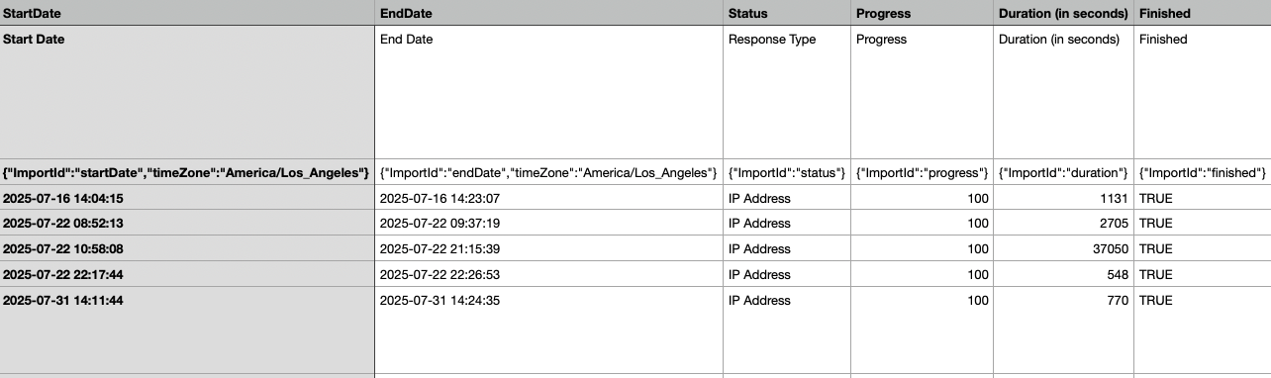

Critique: Fidelity
  Data cleaning
    CSV file has extra rows and columns
      No record of how this was handled
        Create a new data frame called df_clean
        Need to remove the first 2 rows of data
          Filter +str_detect
        Remove columns
          select + starts_with or first_variable:last_col
  Scales
    Ensure they are ordered factors
      glimpse(df)
    Levels
      n_levels <- c(1, 2, 3, 4,)
      t_labels <- c("Strongly Disagree", "Disagree", "Agree", "Strongly Agree")
    Excluded/included participants
      No record of how this was handled
        Include completed responses
          filter() + progress == 100
        Exclude participants who took less than 10 minutes
          >= 600
Notes:
Fidelity: rigor
select: first survey variable name on the left and last_col() on the right (keeps everything in between)
exclude/include: filter( Finished == TRUE| Progress == 100
duration_sec >= 600 (greater than)
make sure duration is numeric

Slide 5
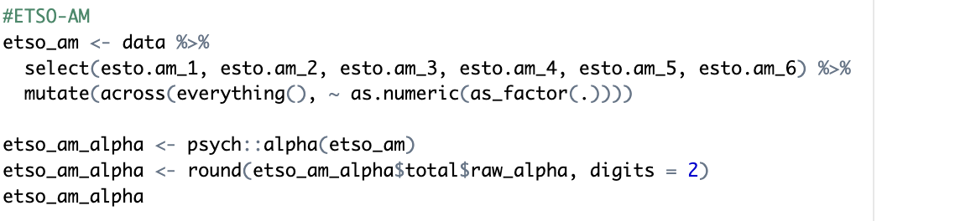
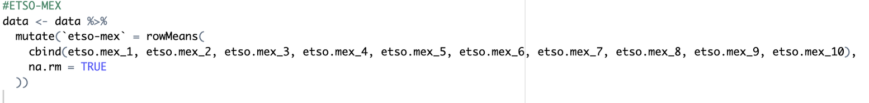


Critique: Efficiency
  Factors
      mutate(across(everyting()
      as.numeric(as_factor()
  Scale reliability
  Composite scores
    Individual blocks of code
  Risks:
    Copy-paste typos/errors
    Have to manually find and edit every single block
  Possible solutions:
    For loops
    Map()
Notes:
Factors: Ordinal levels
continuous composite score

Slide 6



Q & A

